Slide 1
INTERNSHIP PRESENTATION
Pranav Kumar Patil
Class : TE Computer B
Roll No : 20CO089

Slide 2
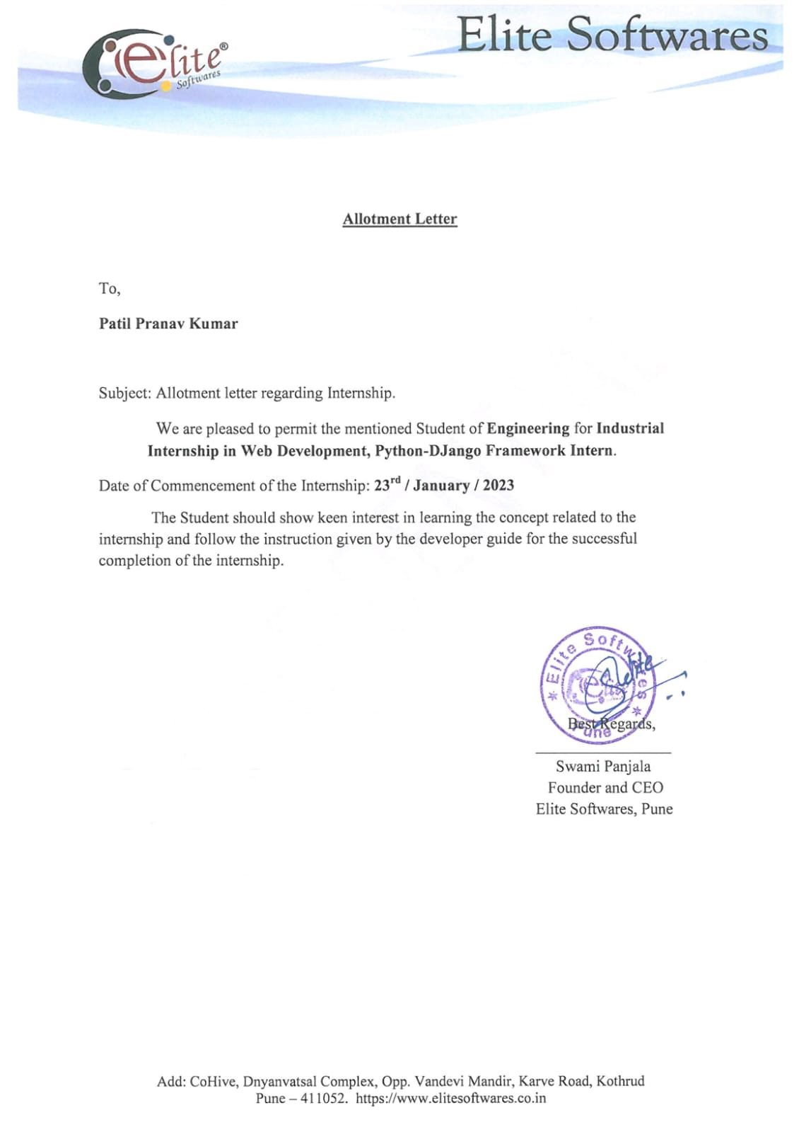
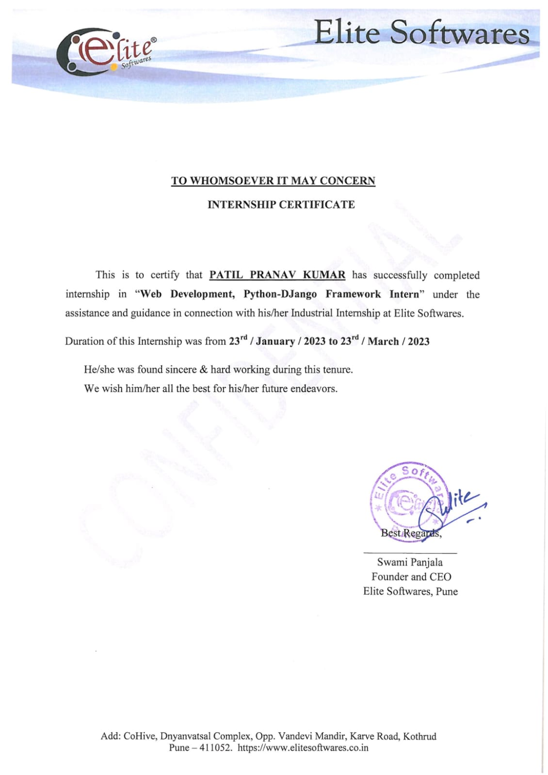
INTERNSHIP CERTIFICATE

Slide 3
INTERNSHIP DETAILS
Internship Organization : Elite Softwares
Internship Duration : 8 Weeks
Starting Date : 23-01-2023
End Date : 23-03-2023
Internship Supervisor : Mr. Swami Panjala
Faculty Guide : Prof. V. S. Gunjal
Internship Coordinator : Prof. S. G. Dhengre

Slide 4
Intern Job Responsibilities
Understands the overall concept of the company, including the brand, customer, product goals, and all other aspects of service.
Accepts designated, business-focus projects to research, propose ideas and solutions, and present final project during the internship.
Engages with customers or clients and provides service and/or sales.
Assists in creating performance reports.

Slide 5
Final outcomes from the Internship
Improved Communication Skills
Analyzing, Organizing and Problem-solving approach
Logical and Abstract thinking
Teamwork and Collaboration Skills
Importance of individual efforts

Slide 6
HTML
HTML (HyperText Markup Language) is the most basic building block of the Web. It defines the meaning and structure of web content.
HTML uses "markup" to annotate text, images, and other content for display in a Web browser.
HTML markup includes special "elements" such as <head>, <title>, <body>, <header>, <footer>, <article>, <section>, <p>, <div>, <span>, <img>, <aside>, <audio>, <canvas>, <details>, <embed>, <nav>, <output>, <progress>, <video>, <ul>, <ol>, <li> and many others.

Slide 7
CSS
Cascading Style Sheets (CSS) is a stylesheet language used to describe the presentation of a document written in HTML or XML (including XML dialects such as SVG, MathML or XHTML).
CSS describes how elements should be rendered on screen, on paper, in speech, or on other media.
CSS is among the core languages of the open web and is standardized across Web browsers according to W3C specifications.

Slide 8
JAVASCRIPT
JavaScript (JS) is a lightweight, interpreted, or just-in-time compiled programming language with first-class functions.
While it is most well-known as the scripting language for Web pages, many non-browser environments also use it, such as Node.js, Apache CouchDB and Adobe Acrobat.
JavaScript is a prototype-based, multi-paradigm, single-threaded, dynamic language, supporting object-oriented, imperative, and declarative (e.g. functional programming) styles.

Slide 9
BOOTSTRAP
Bootstrap is a free and open-source CSS framework directed at responsive, mobile-first front-end web development.
It contains HTML, CSS and (optionally) JavaScript-based design templates for typography, forms, buttons, navigation, and other interface components.
Bootstrap is an HTML, CSS and JS library that focuses on simplifying the development of informative web pages (as opposed to web applications).

Slide 10
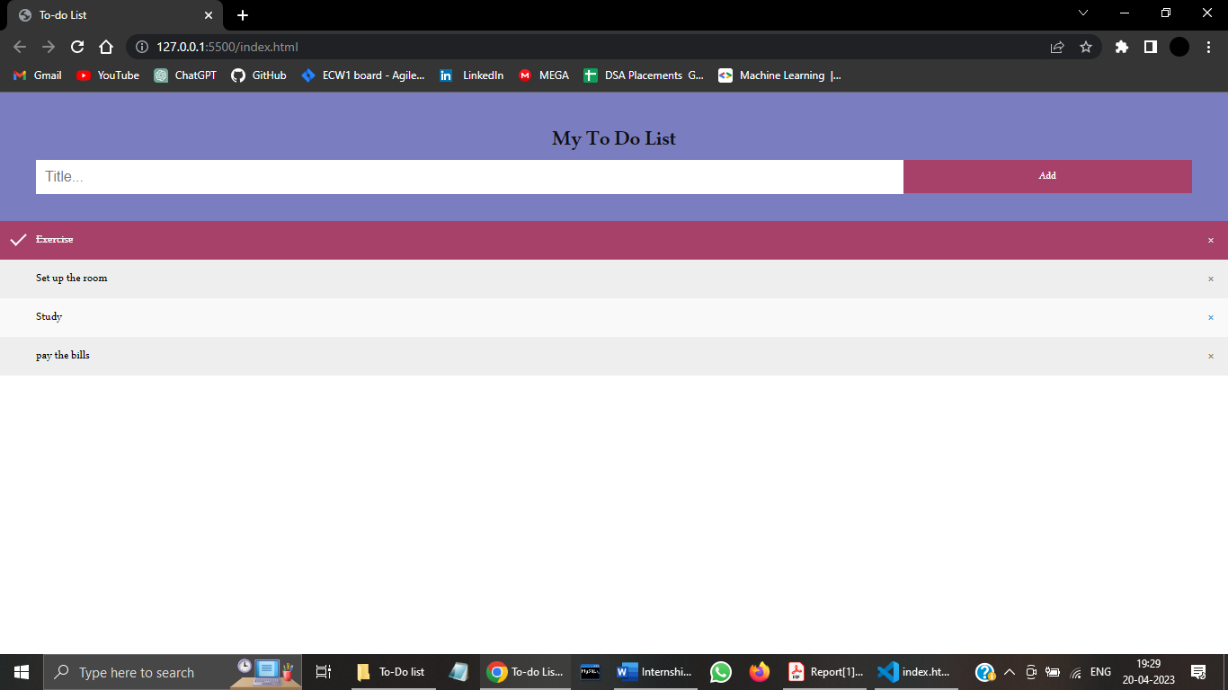
User Interface

Slide 11
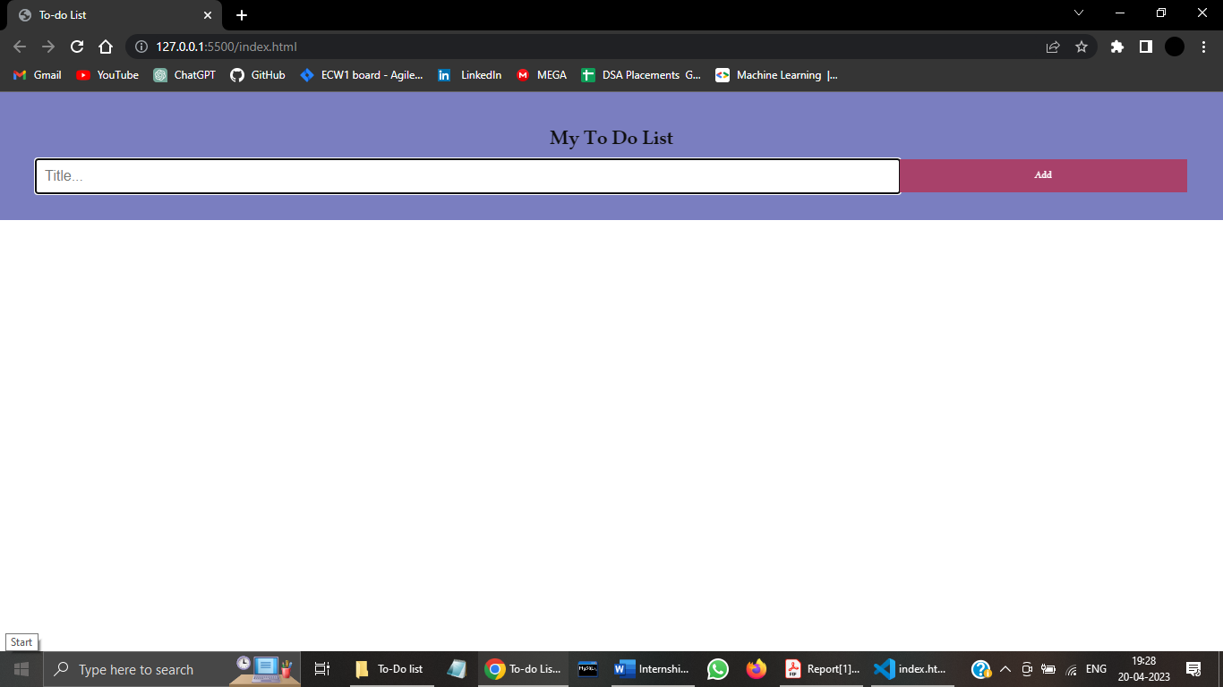
Web-App Cutouts
This is the basic interface of the To-Do Web app before adding tasks to it.

Slide 12
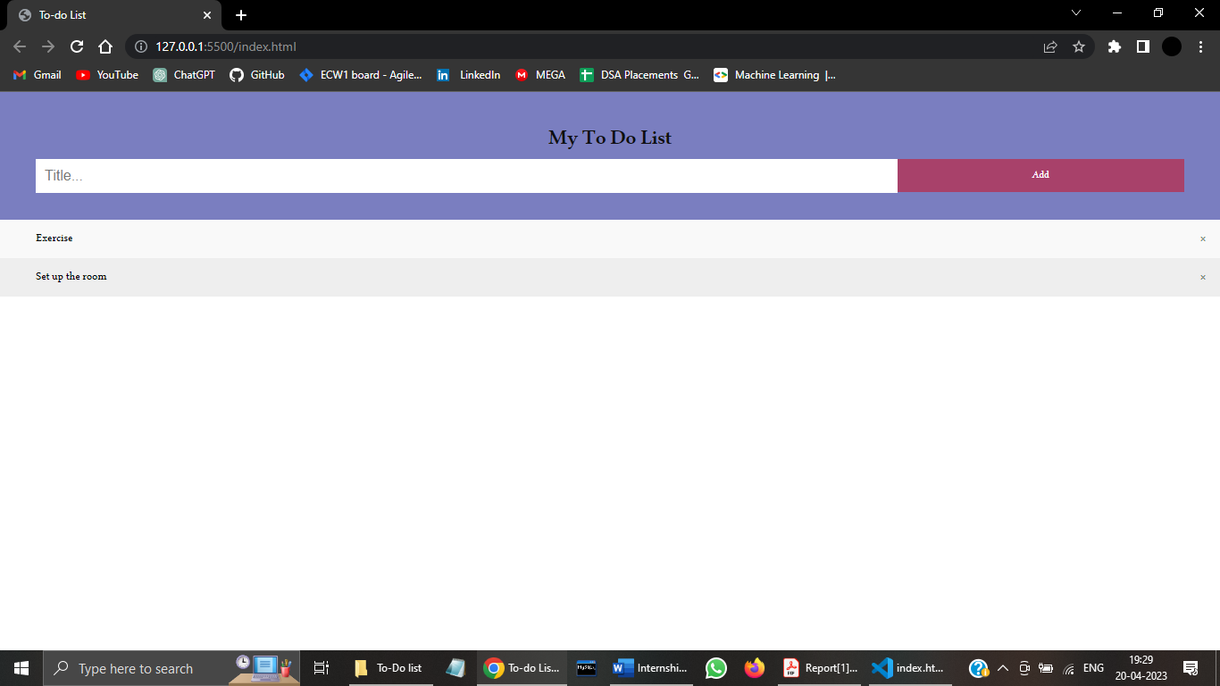
Web-App Cutouts
After adding the tasks to the interface by writing and clicking on “Add” button.

Slide 13
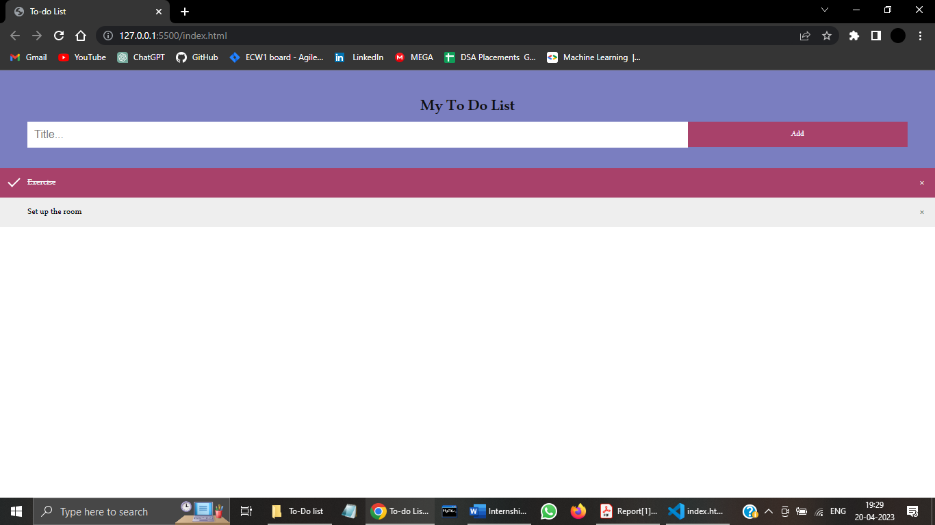
Web-App Cutouts
After completing the task you can directly click on the task bar and it will cross it with a horizontal line and ticking it with a tick mark.

Slide 14
Internship Experience
During my internship with the company, I learned all related development activities, such as client-side scripting, server-side scripting, server and network security settings, e-commerce development, and content management system (CMS) development, in addition to web markup and code.
I was able to put these skills in practice in Web Development projects and one such project is this project which is entitled as Computer Department Website. The work was challenging, and I learned web Development using ReactJS, Python and Django framework about the work and gained more confidence in myself. It was a valuable experience.

Slide 15
Conclusion
In this 60 days, I have learnt how to work as per client requirements and develop accordingly. It improved my way of understanding the idea and delivering it to the clients. It also gave me an experience to submit work before the deadline.
On the whole, this internship was useful experience. We have gained now knowledge. Skills and met many people. We achieved our learning goals. We got insight into professional practice currently advocated in the industry. We learned the different facts of working within a well-established industry.
The internship was also good to find out what our strengths and weakness. This helped us to define what skills and knowledge we have to improve in the coming time.

Slide 16
Thank you!

